Slide 1

How Docker is Changing IT
5 YEARS CREATING AN INDUSTRY OF INNOVATION

Slide 2

Mainframe to PC
90'S
Baremetal to Virtual
00'S
Datacenter to Cloud
10'S
Host to Container (Serverless)
Let's Recap
MAJOR INFRASTRUCTURE SHIFTS

Slide 3

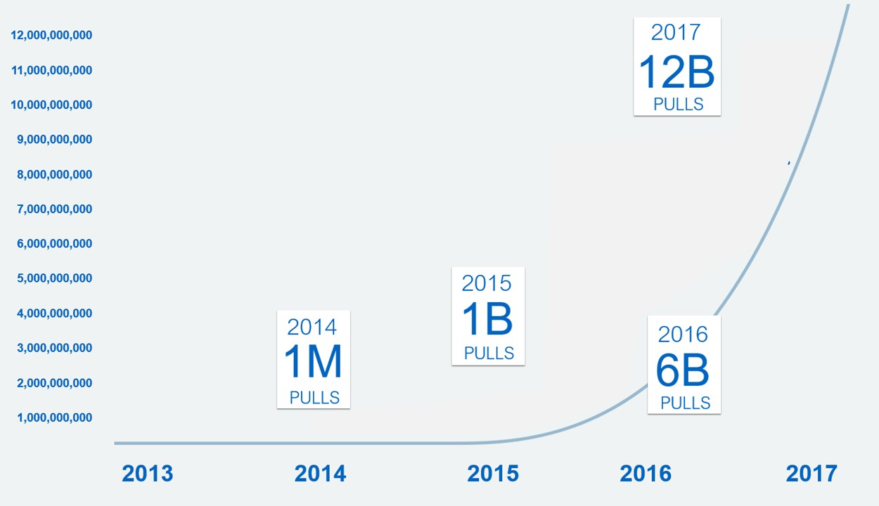


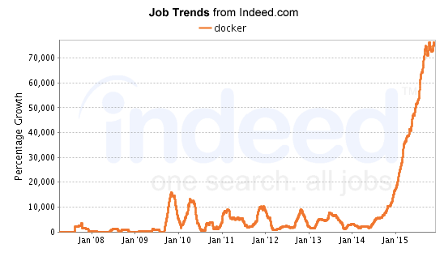
Containers are the “Fastest Growing Cloud Enabling
Technology”
By 2020, more than 50% of global organizations will be running containers in production.
-Gartner
2017
24B
PULLS
Title source: 451 Research

Slide 4

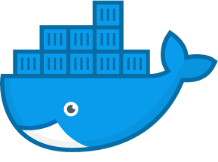
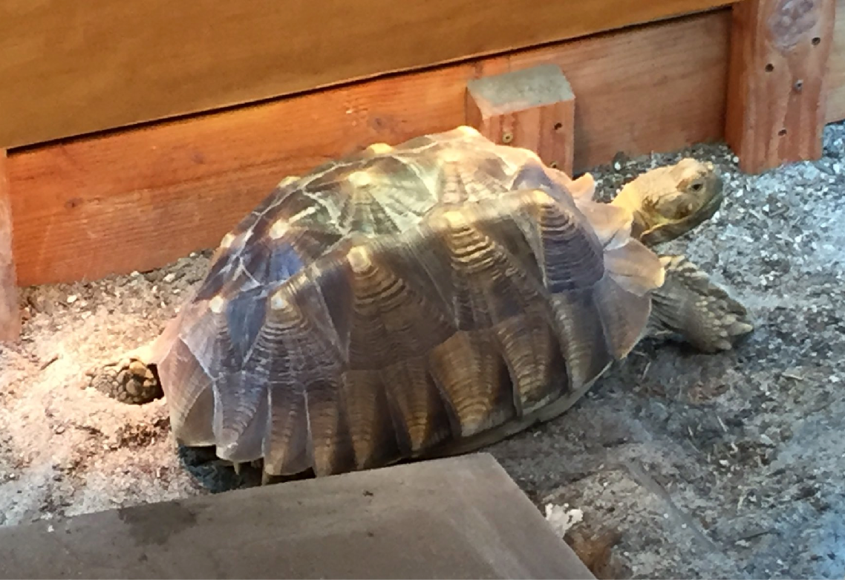
@gordonTheTurtle
@docker
What will Docker do for me?

Slide 5
Docker is all about speed. Develop Faster.
Build Faster. Test Faster.
Deploy Faster. Update Faster. Recover Faster.

Slide 6
The “Matrix from Hell” Breeds Complexity
Static Website | ? | ? | ? | ? | ? | ? | ? | ?
Web Frontend | ? | ? | ? | ? | ? | ? | ? | ?
Background Workers | ? | ? | ? | ? | ? | ? | ? | ?
User DB | ? | ? | ? | ? | ? | ? | ? | ?
Analytics DB | ? | ? | ? | ? | ? | ? | ? | ?
Queue | ? | ? | ? | ? | ? | ? | ? | ?
 | Desktop | Test/QA Cluster | Production Cluster | Public Cloud | Data Center | Mainframe | Windows Server | Edge Device

Slide 7
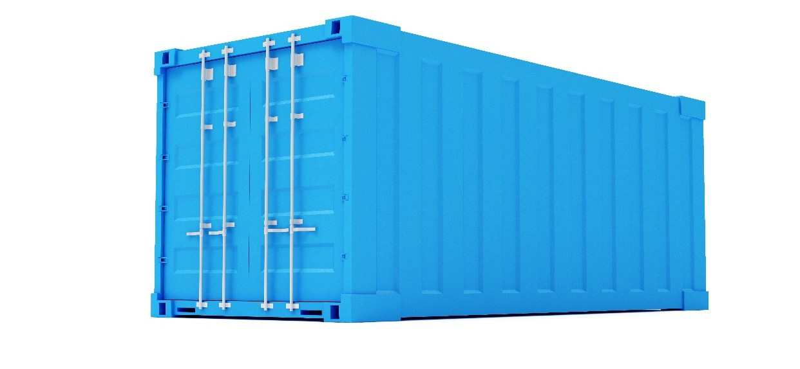
Containers Reduce Complexity
Static Website
Web Frontend
? ? ? ? ? ? ?
? ? ? ? ? ? ?
? ? ? ? ? ? ?
? ? ? ? ? ? ?
? ? ? ? ? ? ?
? ? ? ? ? ? ?
Background Workers
User DB Analytics DB Queue
Desktop
Test/QA Cluster
Production Cluster
Public Cloud
Data Center
Mainframe
Windows Server
Edge Device

Slide 8
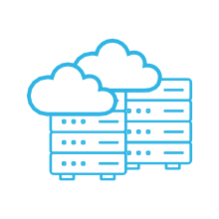



Maintenance and Complexity Drains Budgets, So Innovation Suffers
Stalled Initiatives
Modernizing legacy apps
Cloud migration
Server consolidation
Faster s/w time to market
!
IT demands
increasing!
<20% server utilization***
80%
MAINTENANCE
8+
IT Silos*
1000’s
of apps
60% of CIOs say
“We’re behind in digital transformation”**
20%
INNOVATION
* Average number infrastructures in the enterprise (on-prem and cloud)
** Forrester, CIO and the emerging Digital Crisis, 2018
*** CloudPhysics, Global IT Data Lake Report, Q4, ‘16
Sources: IDC “The Cost of Retaining Aging IT Infrastructure”, RightScale 2017 State of the Cloud Report

Slide 9
























500+ Build Their Containerization Strategy with Docker Enterprise Edition
Oil & Gas / Energy
Healthcare & Science
Financial Services
Tech
Insurance
Public Sector
docker.com/customers

Slide 10




18 Month project
Migrated 700+ apps
70% reduction in VM costs 67% fewer CPU's
10x average CPU utilization 66% cost reduction
Now 150,000 containers 50% dev productivity boost
https://blog.docker.com/2017/10/metlife-docker-enterprise-edition-self-funded-containerization/
https://blog.docker.com/2017/12/containers-at-paypal/

Slide 11





































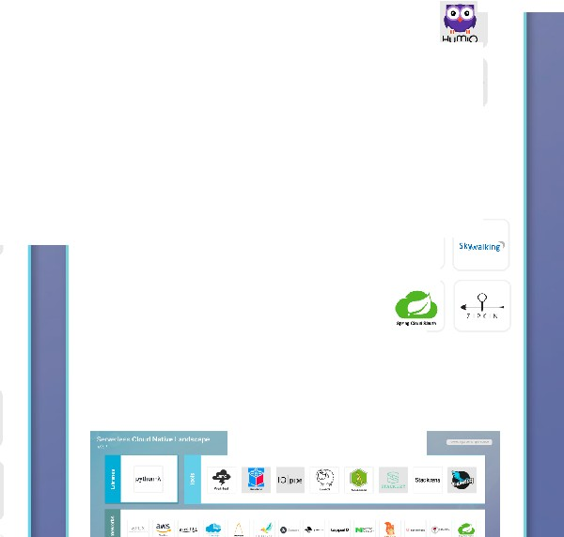






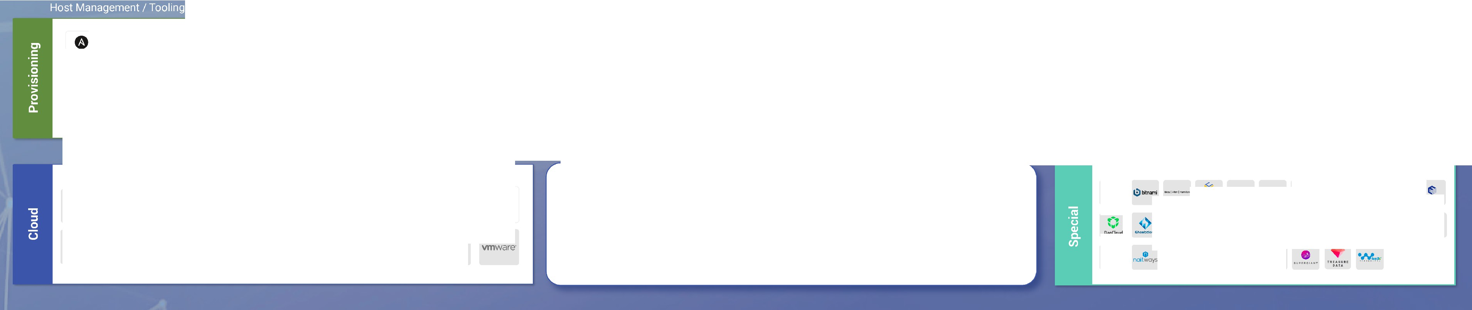







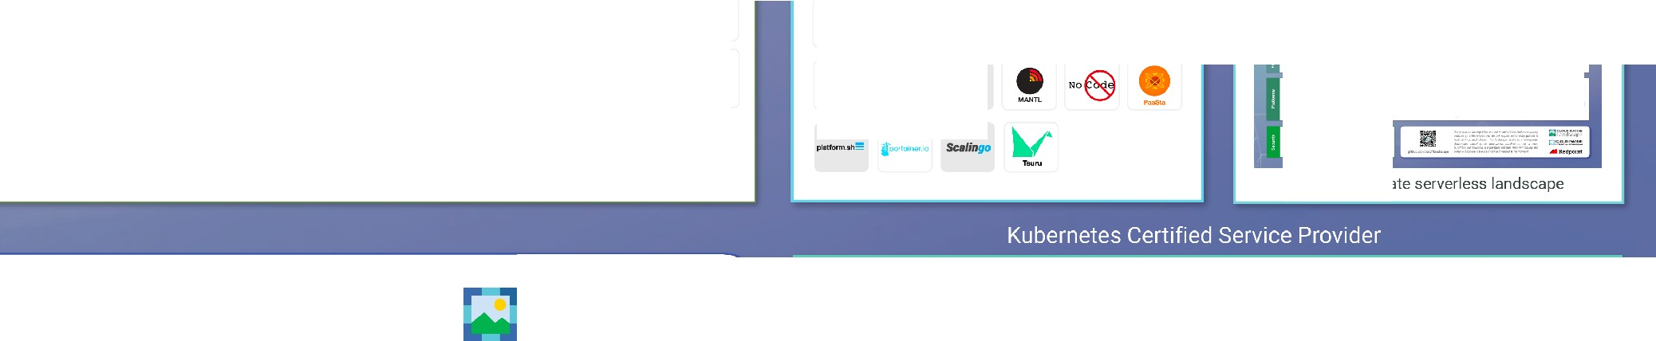
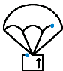
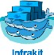








See the interactive landscape at landscape.cncf.io
Greyed logos are not open source
V
,:£) DIGCHAIN°⁸ c.,••...,_
T w
+
nifie
apache bnooklyn
0
i
e buddy
Certified Kubernetes - Distribution
0
Monitoring
ArangoDB
O>d:u'o«l11.om Couchbase C R.A TE,10
a
bitnami
AppVeyor
°'90
Bamboo
-. Bu illfk.ite ^{::) CiC' lecl} .-;Skyca p dou<.,'ees
caicloud
•
•
Jr .M.
e
StreamSets"
Bltbucket
GitHub
rs
••
•
.J
.:.Y"OYN/\MICS
• •
AXIBASE
s:\
'
(!! bole
<fr>
a
AppNeta
,' ,..·'-" ,..''
-
MySQL.
"' O1
ient 08
presto:: }
uouo,v,r1u
d '.;1:: 11
,\ .. ,• ..H. f:i ^{openstaclt}
Prometheus
C 0
Vitess
MonoDB MEMSQ L
P•Sh"dCo
COAtOUIW
•
bltu$aH
Zuul
'Diamanti
ooct cu
tlhoet cloud
G009c:Cbt.id
C
COSCALE
CNCF Incubating
f ,
(·)
snowflake
CNCF Incubating
§::kofko
^{£!- >uLsAR} 11,R• bblil,'0
tl
Gitlab
--
$
©wercker
@
DEPIDV
,/ -
0
CNCF Incubating
centr eon Cobo
e redis
, ._ ,
RelhlnkOB
STA=eURST
OJ.T. A
Solonol.aDt
TravisCl
we av e
E:)heptio
( )
IBMCloud
Pa c ker
flux
in iuinSTACK
Joyent
0
Q (J
•
--:x:.
M RA JTIS
....
ORACLE
DATADOG (Jy· 1cL·d le
Grofono
O RACL E
^{Pivoto r P L A}•^{TF Q M'l}
0TEC10NIC
4t
^{RANCHER} SAMSUNG SOS
Jtic1nGA © in flurd b
INSTL\NI\
$ 1RO N db
librato
4=
LIGH TSTEP
.,.
MES OS
QFt.1Sion
vmware-
meros fi!agios · IN]
/\VI
r,: Ol•C1 c ..,IJI \'
G:::
Consul
{[* 3SCALE
Apache Thrift
I\ b ac kpl ane
....
w
o etcd
16RPC,
CONOUIT
..=.=.
O utly er
Amazon ECS
ContainerPilot
envoy
Eiheptio
Cont ou r
-^{A}-­
Kong
NETFLIX
ZUUL
opbeat
0 19'1!!:N T SO B
rocono
sensu
kubernetes
0
CoreDNS
NETFLIX
EUREKA
Sky005
£
vmw are·
Haret
LINKERD
l stio
Certified Kubernetes - Platform
SENTRY
;-,:-. "" dens i ty
signal fx
StackRox
StockStote
CNCF Graduated
Nomad
CNCF Incubating
airbnb
Sma,tSt.lck
CNCF Incubating
CNCF Incubating
CNCF Sandbox
NETFLIX
RIBBON
i
l'\.oloudo C·J
Al;o at,aC IOud
0 Sysd ig Cm.??.
wfve
OpenPolicy A9en1
tr a, fik
vamp
-
\:.I.-
I
Tttlceo tO:OJd
cloud
Logging
..y;-;
\) elast ic
Le GGL Y
(_)
ORAc:L.E
-
HUAWI E I BM Cloud nirmata
@
8;; () DATERA
t,.po reto ,.,a, a m x [!: I
₋ca₋n₋a₋l --
fluentd
(f \ogz:.io
semotiext
splunk>
ffl
e
s;io
ZTE
Non-Certified Kubernetes
ceph CSI
OOI.LEMC
o/ 'Dlamand
HEDVIG
nfi nit
lg]
ca­
-C-ont-iv
CUMULUs,,,'
a
sunoog,c
Tracing
(ID
ROOK
?...
n
V
@ cri-o
kata
f flannel C •ii!•m idonet _{NSX}
cilium
CNCF Incubating
&. Leo FS
"'llf
OJoye nf
MANTA
r
nSDS
l r,,:-;1·wo1x
rkt
lxd
,mw,are-
0vS
kasten
MINIO
NetApp·
1'iJp e nE:OS
II
CN I
GuardiCore
OpenvSwilth
0
@
1.uo l.:1n c1Sohtp
...
goPaddle
H-U- -
('
PURESTORAGE
@
Quobyte
a,n tain &rl!I
ijPouch
runV
'-'icfWCQ A.
Amazont KS
I,
Appdash
CNCF Sandbox
springpath
SWIFT
CNCF Incubating
CNCFIncubating
Singularity
SmartOS
CNCF Incubating
@ PW Mgr<
ROMI\NI\
snoproute
weave
AWEI
R OS IN
net
r: •
..
= n- -A c :: , •..C , u 1> £ i;eGI A.M f
OPEN TRACING
Infr.astr.ucture
PaaS/Container Service
CNCF Incubating
CNCF Incubating
APCERA
0
. 0 /ITA'tllRE
Serverless
CFEngine C
-₋
8 ®
lyA
CONFIDANT
•
ce>nvox
Mi#l@Pii tWMMiiMMll'tNW
AN SI B LE
CHEF
coreo
)'.&..(
HELM
¥
Ii]
[iJcta ; y
anchore -
.a
CQ clair
remind
Flynn
Iii
DI
C L O l, D
aqua
KeyWhiz
KNOX
Q}
c LOUOIFY
cod cf: rc-sh
REGISTRY
,,
· va u1t
·­
E XOSCALE
•
heroku
HYPER.SH
BLACK DUC K
-··
? RUN DECK
•
Amazon ECR
Azure Regi&-try
-
·-·
SP1FF1c
i
@ -
unuHl:m
:),puppet
-
-
--Terraform
0
Jf'rogArtlfartory
-
-
SPIRE
KONTENA
- ,.- -· e .<"' e •-· -- .,,Q c.- - -\r.r. r,. 4- • §' ·- .! .
. •• .., ... ::. ;;,... .... - -- CD00 r.i - .• •,. ( .• i. .,,,... - - .,! - r ;_,.
JUJU
©
•
«) QUAY
T U F
JHiO_,
Li<:1tbenc
&
Manage lQ
HARBOR.,
CNCF Incubating
CNCF Incubating
NeuVector
OpenSCAP
Sonatt pe
Twistlock
SALTSTACK
Kubicom
Nexus
See the separate serverless landscape
This landscape is intended as a map through the previously uncharted terrain of cloud native technologies. There are many routes to deploying a cloud native applica­ tion, with CNCF Projects representing a particularly well-traveled path.
Landscape
t':1 CLOUD NATIVE
COMPUTING FOUNDATION
e
CLOUD NATIVE
claranet cD
CONTINO 0
>
, ..;.-, ..
L...)
IBM Cloud
.. !!,
"':
CJ
aws
A Azure
0 Baidu Cloud
FUJITSU
fi;1DIGITAL
q,,,REBRA
FOREMAN
MAAS
accenture
caicloud
CAN8NI CAL
CloudOPS
Alibaba Cloud
₋\_{r,} I /
DigitalOcean
Google Cloud
₋:""":
-«. H he ptio
Cio.ntSwwm
' J£TS TACK
•
LI Vc\'1/':'cR t!ll1oodse
- -­
(_)
0
<Pack.et
Gho• l:d oud
HUAW EI
it'lw in sr ACK
HUAWEI
IBM Cloud
Joyent
ORACLE
Te nc en t Cloud
openstack.
Scaleway
github.com/cncf/landscape
...illlll Redpoint I/Am pli f y
F-> AK N K ::>
-
RX-M:,:°•,
4Jlll'
.-uNGSOS
-
STACK
P OI N T
CLOUD
MIRANTIS
nlrmata

Slide 12
Docker Editions
Learn about the various (dozen+) Editions of Docker
Learn which to use for this course
Learn Docker CE vs. EE
Learn Stable vs. Edge releases

Slide 13
Docker Editions at store.docker.com
Docker is no longer just a "container runtime"
Docker moves fast, it matters how you install it
Linux (different per distro, don’t use default package)
Docker Desktop (Recommended for Windows and Mac)
Docker Toolbox (Legacy for Win10 Home/Win7/Win8)

Slide 14
Community vs. Enterprise
Docker Community (free) vs. Docker Enterprise (paid)
Old Name "EE" = Enterprise Edition (same thing)
Windows Server 2016 comes with Enterprise Basic
Linux servers are a target for Enterprise
Enterprise also gets you GUI apps like DTR and UCP
Developers and Sysadmins use Community locally

Slide 15
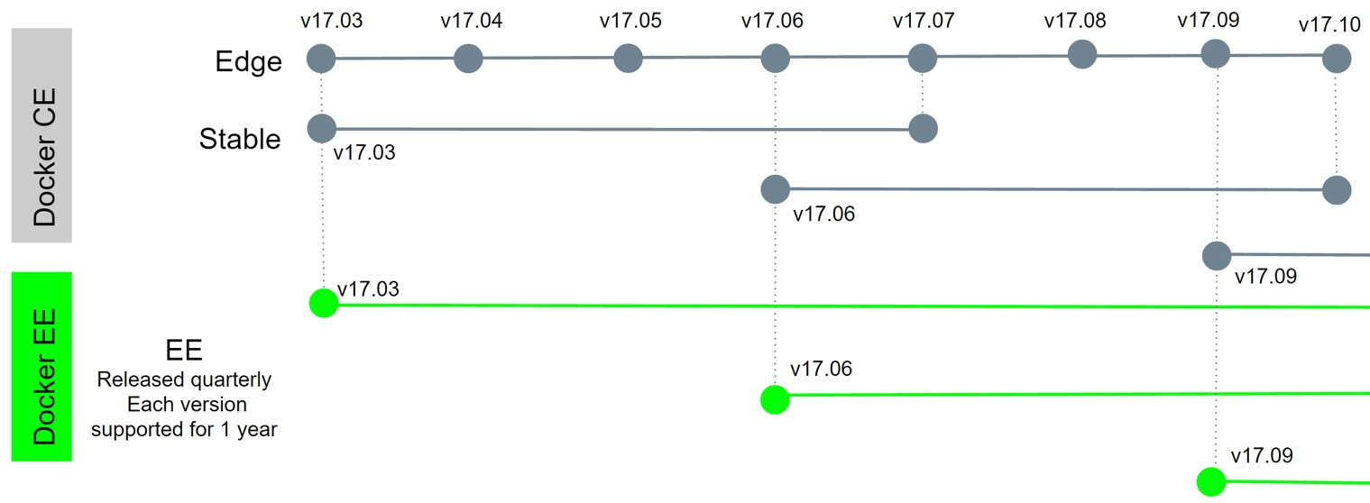
Stable vs.Edge
Edge (beta) released monthly, Stable quarterly
Edge gets new features first, but only supported for a month
Stable rolls in three months of Edge features, EE supported longer

Slide 16
Docker on Windows
Learn the two types of containers Windows can run
Learn which Docker Edition to install on your Windows version
Learn differences between Windows 10 and Windows Server 2016

Slide 17
Docker on Windows Overview
Two Types of Containers: Linux Containers and Windows Containers
Linux Containers still default, when I say "containers" I mean Linux
Best experience: Docker for Windows, but Win10 Pro/Ent only
Win7/8/8.1 or Win10 Home should use Docker Toolbox
Windows Server 2016 also supports Windows Containers
Getting better all the time
e.g. Native Linux containers coming soon

Slide 18
Docker on Windows 10 Pro
Use Docker for Windows, from store.docker.com
More features then just a Linux VM
Uses Hyper-V with tiny Linux VM for Linux Containers
PowerShell native

Slide 19
Docker for Mac
Use Docker for Mac, from store.docker.com
More features then just a Linux VM
Uses "xhyve" with tiny Linux VM for Linux Containers
Terminal/iTerm native
PowerShell native

Slide 20
Docker on Windows 7/8 and 10 Home
Use Docker Toolbox, not as fancy as Docker for Windows
Like others, download at store.docker.com
Runs a tiny Linux VM in VirtualBox via docker-machine
Uses a bash shell to make it more like Linux/Mac options
Does not support Windows Containers
Must put all your code in C:\Users\<your-username>

Slide 21
Docker on Windows Server 2016
Windows Server 2016 supports native Windows Containers
”Docker for Windows” runs on Win 2016 but not required
Only do this for when you run Win 2016 locally for dev/test. NOT for prod
No options for previous Windows Server versions
Hyper-V can still run Linux VM's (that can run Docker) just fine

Slide 22
Docker for Windows Setup
Install Docker
Tweak Docker for Windows settings
Clone my GitHub repo
Get a code editor
Tweak your terminal and shell (optional)

Slide 23
Docker for Windows Tips
PowerShell Command Completion: posh-docker
https://docs.docker.com/docker-for-windows/#set-up-tab-completion-in-powershell
Code paths enabled for Bind Mounts (C:\Users by default)
Bind Mounts work for code (but often not databases)
Backup option: use docker-machine create --driver hyperv
https://docs.docker.com/machine/drivers/hyper-v/
Great Dockerfile/Compose file editor: Visual Studio Code
https://code.visualstudio.com/
Great Terminal UI replacement: cmder
http://cmder.net/
Great info and troubleshooting/FAQ
https://docs.docker.com/docker-for-windows/

Slide 24
Docker Toolbox on Windows Setup
Install Docker
Clone my GitHub repo
Start the Docker Quickstart Terminal
Tweak Docker VM settings
Get a code editor
Tweak your terminal and shell (optional)

Slide 25
Docker Toolbox on Windows Tips
Use the Docker Quickstart Terminal to start with
In background it auto-creates and auto-starts VM
Defaults to bash shell
Code paths enabled for Bind Mounts work in C:\Users only
Bind Mounts work for code (but often not databases)
Re-create Linux VM or create more with docker-machine
Great Dockerfile/Compose file editor: Visual Studio Code
https://code.visualstudio.com/
Great Terminal UI replacement: cmder
http://cmder.net/

Slide 26
Docker on macOS Overview
Docker for Mac
Requires Yosemite 10.10.3 (2014 release)
Yosemite works with 2007-2008 Mac's and newer
Docker Toolbox
For Snow Leopard, Lion, Mountain Lion (10.6-10.8)
Docker in a Linux VM
Docker in a Windows VM
Not usually possible, only works with Vmware Fusion
Don't use homebrew (brew install docker), it's docker CLI only

Slide 27
Docker for Mac: Setup
Install Docker
Tweak Docker for Mac settings
Clone my GitHub repo
Get a code editor
Tweak your terminal and shell (optional)

Slide 28
Docker for Mac Tips
Bash Command Completion
https://docs.docker.com/docker-for-mac/#installing-bash-completion
Code paths enabled for Bind Mounts (/Users by default)
Bind Mounts work for code and (usually) databases
Run more nodes: docker-machine create --driver
Fusion, VirtualBox, Parallels, etc. https://docs.docker.com/machine/drivers/
Great Dockerfile/Compose file editor: Visual Studio Code
https://code.visualstudio.com/
Great Terminal replacement: iTerm2
https://www.iterm2.com/
Great info and troubleshooting/FAQ
https://docs.docker.com/docker-for-mac/
My Shell Setup (iTerm2 + oh-my-zsh + much more)
http://www.bretfisher.com/shell

Slide 29
Docker on Linux
Easiest install/setup, best native experience
Three main ways to install: script, store, or docker-machine
get.docker.com script (latest Edge release)
curl -sSL https://get.docker.com/ | sh
store.docker.com has instructions for each distro
RHEL officially only supports Docker EE (paid), but CentOS will work
Installing in a VM, Cloud Instance, all are the same process
May not work for unlisted distros (Amazon Linux, Linode Linux, etc.)
Don't use pre-installed setups (Digital Ocean, Linode, etc.)

Slide 30
Docker for Linux: Setup
Install Docker
Add your user to docker group
Clone my GitHub repo
Get a code editor
Tweak your terminal and shell (optional)

Slide 31
Docker for Linux Tips
After installing Docker, also get docker-compose and docker- machine
https://docs.docker.com/machine/install-machine/
https://docs.docker.com/compose/install/
Run more nodes: docker-machine create --driver
VirtualBox, AWS, etc. https://docs.docker.com/machine/drivers/
Great Dockerfile/Compose file editor: Visual Studio Code
https://code.visualstudio.com/
Bash command completion just works

Slide 32
What's In This Section
Check versions of our docker cli and engine
Create a Nginx (web server) container
Learn common container management commands
Learn Docker networking basics
Requirements: Have latest Docker installed from last Section

Slide 33
What We Covered
command: docker
version
verified cli can talk to engine
command: docker
info
most config values of engine
docker command line structure
old (still works): docker <command>
(options)
new: docker <command> <sub-command> (options)

Slide 34
Container VS Virtual Machine
Containers aren’t Mini-VM’s
They are just processes
Limited to what resources they can access (file paths, network devices, running processes)
Exit when process stops
docker run --name mongo -d mongo
docker top mongo
ps aux
docker stop mongo
ps aux

Slide 35
This Lecture
image vs. container
run/stop/remove containers
check container logs and processes

Slide 36
Image vs. Container
An Image is the application we want to run
A Container is an instance of that image running as a process
You can have many containers running off the same image
In this lecture our image will be the Nginx web server
Docker's default image "registry" is called Docker Hub (hub.docker.com)

Slide 37
docker container run --publish 80:80 nginx
Downloaded image 'nginx' from Docker Hub
Started a new container from that image
Opened port 80 on the host IP
Routes that traffic to the container IP, port 80

Slide 38
What happens in 'docker container run’
Looks for that image locally in image cache, doesn't find anything
Then looks in remote image repository (defaults to Docker Hub)
Downloads the latest version (nginx:latest by default)
Creates new container based on that image and prepares to start
Gives it a virtual IP on a private network inside docker engine
Opens up port 80 on host and forwards to port 80 in container
Starts container by using the CMD in the image Dockerfile

Slide 39
Example Of Changing The Defaults
change version of image
docker container run --publish 8080:80 --name webhost -d nginx:1.11 nginx
-T
change host listening port
change CMD run on start

Slide 40
Assignment: Manage Multiple Containers
docs.docker.com and --help are your friend
Run a nginx, a mysql, and a httpd (apache) server
Run all of them --detach (or -d), name them with --name
nginx should listen on 80:80, httpd on 8080:80, mysql on 3306:3306
When running mysql, use the --env option (or -e) to pass in
MYSQL_RANDOM_ROOT_PASSWORD=yes
Use docker container logs on mysql to find the random password it created on startup
Clean it all up with docker container stop and docker container rm (both can accept multiple names or ID's)
Use docker container ls to ensure everything is correct before and after cleanup

Slide 41
What's Going On In Containers
docker | container | top - process list in one container
docker | container | inspect - details of one container config
docker | container | stats - performance stats for all containers

Slide 42
Getting a Shell Inside Containers
docker container run
docker container exec
existing container
-it - start new container interactively
-it - run additional command in
Different Linux distros in containers

Slide 43
Docker Networks: Concepts
Review of docker container run -p
For local dev/testing, networks usually "just work"
Quick port check with docker container port <container>
Learn concepts of Docker Networking
Understand how network packets move around Docker

Slide 44
Docker Networks Defaults
Each container connected to a private virtual network "bridge"
Each virtual network routes through NAT firewall on host IP
All containers on a virtual network can talk to each other without -p
Best practice is to create a new virtual network for each app:
network "my_web_app" for mysql and php/apache containers
network "my_api" for mongo and nodejs containers

Slide 45
Docker Networks Cont.
"Batteries Included, But Removable"
Defaults work well in many cases, but easy to swap out parts to customize it
Make new virtual networks
Attach containers to more then one virtual network (or none)
Skip virtual networks and use host IP (--net=host)
Use different Docker network drivers to gain new abilities
and much more...

Slide 46
Docker Networks: CLI Management
Show networks docker network ls
Inspect a network docker network inspect
Create a network docker network create --driver
Attach a network to container docker network connect
Detach a network from container docker network disconnect

Slide 47
Docker Networks: Default Security
Create your apps so frontend/backend sit on same Docker network
Their inter-communication never leaves host
All externally exposed ports closed by default
You must manually expose via -p, which is better default security!
This gets even better later with Swarm and Overlay networks

Slide 48
Docker Networks: DNS
Understand how DNS is the key to easy inter-container comms
See how it works by default with custom networks
Learn how to use --link to enable DNS on default bridge network

Slide 49
Docker Networks: DNS
Containers shouldn't rely on IP's for inter-communication
DNS for friendly names is built-in if you use custom networks
You're using custom networks right?
This gets way easier with Docker Compose in future Section

Slide 50

Assignment Requirements: CLI App Testing
Know how to use -it to get shell in container
Understand basics of what a Linux distribution is like Ubuntu and CentOS
Know how to run a container

Slide 51
Assignment: CLI App Testing
Use different Linux distro containers to check curl cli tool version
Use two different terminal windows to start bash in both centos:7
and ubuntu:14.04, using -it
Learn the docker container run —rm option so you can save cleanup
Ensure curl is installed and on latest version for that distro
ubuntu: apt-get update && apt-get install curl
centos: yum update curl
Check curl --version

Slide 52
Assignment Requirements: DNS RR Test
Know how to use -it to get shell in container
Understand basics of what a Linux distribution is like Ubuntu and CentOS
Know how to run a container
Understand basics of DNS records

Slide 53
Assignment: DNS Round Robin Test
Ever since Docker Engine 1.11, we can have multiple containers on a created network respond to the same DNS address
Create a new virtual network (default bridge driver)
Create two containers from elasticsearch:2 image
Research and use —network-alias search when creating them to give them an additional DNS name to respond to
Run alpine nslookup search with --net to see the two containers list for the same DNS name
Run centos curl -s search:9200 with --net multiple times until you see both "name" fields show

Slide 54
This Section
All about images, the building blocks of containers
What's in an image (and what isn't)
Using Docker Hub registry
Managing our local image cache
Building our own images
VOLUME and mounting host data
Images for different CPU architectures
Windows images and how they differ

Slide 55
What's In An Image and What Isn't)
App binaries and dependencies
Metadata about the image data and how to run the image
Official definition: "An Image is an ordered collection of root filesystem changes and the corresponding execution parameters for use within a container runtime."
Not a complete OS. No kernel, kernel modules (e.g. drivers)
Small as one file (your app binary) like a golang static binary
Big as a Ubuntu distro with apt, and Apache, PHP, and more installed

Slide 56
Image Creation and Storage
Created Using a Dockerfile
Or committing a containers changes back to an image
Stored in Docker Engine image cache
Move images in/out of cache via:
local filesystem via tarballs
push/pull to a remote "image registry" (e.g. Docker Hub)
Images aren't ideal for persistent data
Mount a host file system path into container
Use docker volume to create storage for unique/persistent data

Slide 57
Image Highlights
Images are made up of app binaries, dependencies, and metadata
Don't contain a full OS
Usually use a Dockerfile recipe to create them
Stored in your Docker Engine image cache
Permanent Storage should be in a Image Registry
Image's don't usually store persistent data

Slide 58
This Lecture
Basics of Docker Hub (hub.docker.com)
Find Official and other good public images
Download images and basics of image tags

Slide 59
This Lecture: Review
Docker Hub, "the apt package system for Containers"
Official images and how to use them
How to discern "good" public images
Using different base images like Debian or Alpine
The recommended tagging scheme used by Official images

Slide 60
This Lecture
Image layers
Union file system
history and inspect commands
Copy on write

Slide 61
Image and Their Layers: Review
Images are made up of file system changes and metadata
Each layer is uniquely identified and only stored once on a host
This saves storage space on host and transfer time on push/pull
A container is just a single read/write layer on top of image
docker image history and inspect commands can teach us

Slide 62
This Lecture: Requirements
Know what container and images are
Understand image layer basics
Understand Docker Hub basics

Slide 63
This Lecture
All about image tags
How to upload to Docker Hub
Image ID vs. Tag

Slide 64
This Lecture: Review
Properly tagging images
Tagging images for upload to Docker Hub
How tagging is related to image ID
The Latest Tag
Logging into Docker Hub from docker cli
How to create private Docker Hub images

Slide 65
Building Images: Requirements
Understand container and image basics from previous lectures
Cloned the class repository from Section 1
Starting in the dockerfile-sample-1 directory

Slide 66
Building Images: The Dockerfile Basics
Dockerfile basics
FROM (base image)
ENV (environment variable)
RUN (any arbitrary shell command)
EXPOSE (open port from container to virtual network)
CMD (command to run when container starts)
docker image build (create image from Dockerfile)

Slide 67
Assignment: Build Your Own Image
Dockerfiles are part process workflow and part art
Take existing Node.js app and Dockerize it
Make Dockerfile. Build it. Test it. Push it. (rm it). Run it.
Expect this to be iterative. Rarely do I get it right the first time.
Details in dockerfile-assignment-1/Dockerfile
Use the Alpine version of the official 'node' 6.x image
Expected result is web site at http://localhost
Tag and push to your Docker Hub account (free)
Remove your image from local cache, run again from Hub

Slide 68
Section Overview
Defining the problem of persistent data
Key concepts with containers: immutable, ephemeral
Learning and using Data Volumes
Learning and using Bind Mounts
Assignments

Slide 69
Container Lifetime & Persistent Data
Containers are usually immutable and ephemeral
"immutable infrastructure": only re-deploy containers, never change
This is the ideal scenario, but what about databases, or unique data?
Docker gives us features to ensure these "separation of concerns"
This is known as "persistent data"
Two ways: Volumes and Bind Mounts
Volumes: make special location outside of container UFS
Bind Mounts: link container path to host path

Slide 70
Persistent Data: Volumes
VOLUME command in Dockerfile
Also override with docker run -v /path/in/container
Bypasses Union File System and stores in alt location on host
Includes it's own management commands under docker
Connect to none, one, or multiple containers at once
Not subject to commit, save, or export commands
By default they only have a unique ID, but you can assign name
Then it's a "named volume"
volume

Slide 71
Persistent Data: Bind Mounting
Maps a host file or directory to a container file or directory
Basically just two locations pointing to the same file(s)
Again, skips UFS, and host files overwrite any in container
Can't use in Dockerfile, must be at container run
... run -v /Users/bret/stuff:/path/container (mac/linux)
//c/Users/bret/stuff:/path/container
... run -v
(windows)

Slide 72
Assignment: Named Volumes
Database upgrade with containers
Create a postgres container with named volume psql-data using version 9.6.1
Use Docker Hub to learn VOLUME path and versions needed to run it
Check logs, stop container
Create a new postgres container with same named volume using 9.6.2
Check logs to validate
(this only works with patch versions, most SQL DB's require manual commands to upgrade DB's to major/minor versions, i.e. it's a DB limitation not a container one)

Slide 73
Assignment: Bind Mounts
Use a Jekyll "Static Site Generator" to start a local web server
Don't have to be web developer: this is example of bridging the gap between local file access and apps running in containers
source code is in the course repo under bindmount-sample-1
We edit files with editor on our host using native tools
Container detects changes with host files and updates web server
start container with
docker run -p 80:4000 -v $(pwd):/site bretfisher/jekyll- serve
Refresh our browser to see changes
Change the file in _posts\ and refresh browser to see changes

Slide 74
Docker Compose
Why: configure relationships between containers
Why: save our docker container run settings in easy-to-read file
Why: create one-liner developer environment startups
Comprised of 2 separate but related things
1. YAML-formatted file that describes our solution options for:
containers
networks
volumes
2. A CLI tool docker-compose used for local dev/test automation with those YAML files

Slide 75
docker-compose.yml
Compose YAML format has it's own versions: 1, 2, 2.1, 3, 3.1
YAML file can be used with docker-compose command for local docker automation or..
With docker directly in production with Swarm (as of v1.13)
docker-compose --help
docker-compose.yml is default filename, but any can be used with docker-compose -f

Slide 76
docker-compose CLI
CLI tool comes with Docker for Windows/Mac, but separate download for Linux
Not a production-grade tool but ideal for local development and test
Two most common commands are
docker-compose up # setup volumes/networks and start all containers
docker-compose down # stop all containers and remove cont/vol/net
If all your projects had a Dockerfile and docker-compose.yml
then "new developer onboarding" would be:
git clone github.com/some/software
docker-compose up

Slide 77
Assignment: Writing A Compose File
Build a basic compose file for a Drupal content management system website. Docker Hub is your friend
Use the drupal image along with the postgres image
Use ports to expose Drupal on 8080 so you can localhost:8080
Be sure to set POSTGRES_PASSWORD for postgres
Walk though Drupal setup via browser
Tip: Drupal assumes DB is localhost, but it's service name
Extra Credit: Use volumes to store Drupal unique data

Slide 78
Using Compose to Build
Compose can also build your custom images
Will build them with docker-compose up
cache
Also rebuild with docker-compose build
or all in one: docker-compose up --build
if not found in
Great for complex builds that have lots of vars or build args

Slide 79
Assignment: Build and Run Compose
"Building custom drupal image for local testing"
Compose isn't just for developers. Testing apps is easy/fun!
Maybe your learning Drupal admin, or are a software tester
Start with Compose file from previous assignment
Make your Dockerfile and docker-compose.yml in dir
compose-assignment-2
Use the drupal image along with the postgres image as before
Use README.md in that dir for details

Slide 80
Containers Everywhere = New Problems
How do we automate container lifecycle?
How can we easily scale out/in/up/down?
How can we ensure our containers are re-created if they fail?
How can we replace containers without downtime (blue/green deploy)?
How can we control/track where containers get started?
How can we create cross-node virtual networks?
How can we ensure only trusted servers run our containers?
How can we store secrets, keys, passwords and get them to the right container (and only that container)?

Slide 81
Swarm Mode: Built-In Orchestration
Swarm Mode is a clustering solution built inside Docker
Not related to Swarm "classic" for pre-1.12 versions
Added in 1.12 (Summer 2016) via SwarmKit toolkit
Enhanced in 1.13 (January 2017) via Stacks and Secrets
Not enabled by default, new commands once enabled
docker swarm
docker node
docker service
docker stack
docker secret

Slide 82
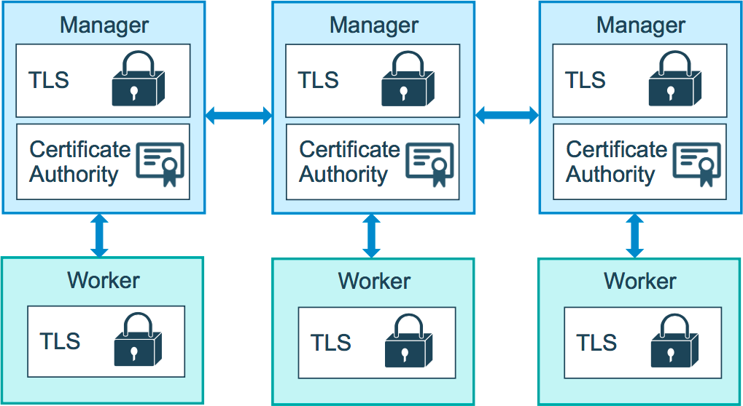

Slide 83
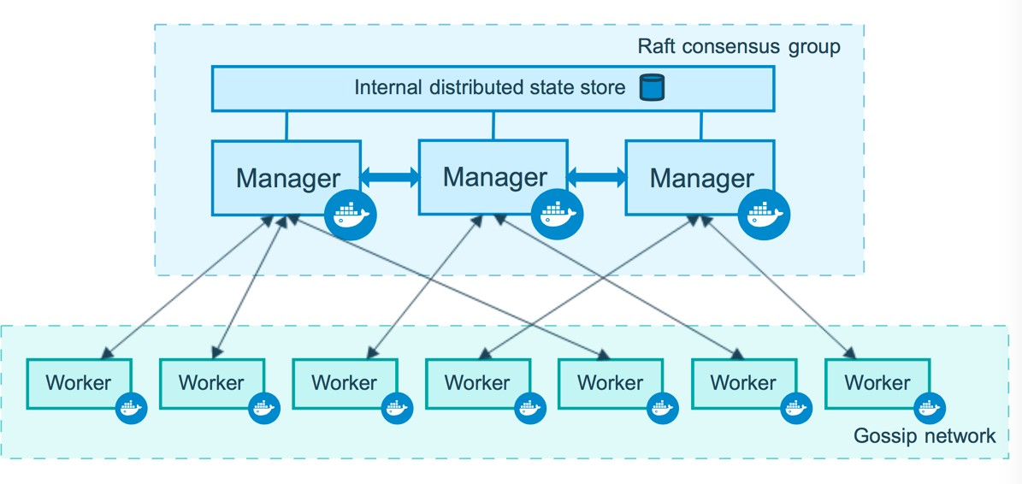

Slide 84
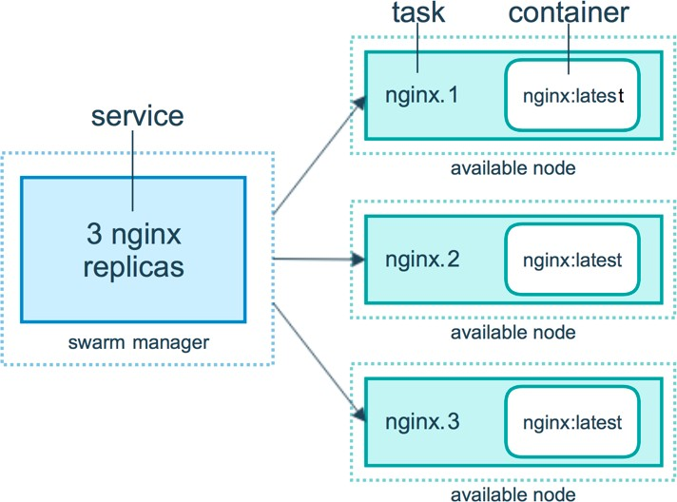

Slide 85
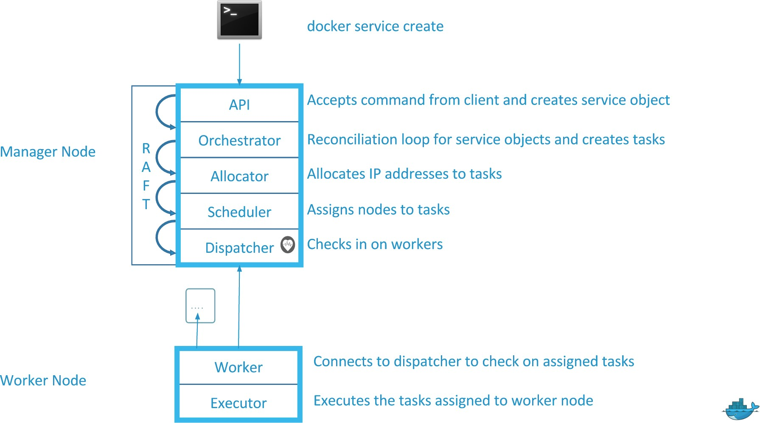

Slide 86
docker swarm init: What Just Happened?
Lots of PKI and security automation
Root Signing Certificate created for our Swarm
Certificate is issued for first Manager node
Join tokens are created
Raft database created to store root CA, configs and secrets
Encrypted by default on disk (1.13+)
No need for another key/value system to hold orchestration/secrets
Replicates logs amongst Managers via mutual TLS in "control plane"

Slide 87
Creating 3-Node Swarm: Host Options
A. play-with-docker.com
Only needs a browser, but resets after 4 hours
B. docker-machine + VirtualBox
Free and runs locally, but requires a machine with 8GB memory
C. Digital Ocean + Docker install
Most like a production setup, but costs $5-10/node/month while learning
Use my referral code in section resources to get $10 free
D. Roll your own
docker-machine can provision machines for Amazon, Azure, DO, Google, etc.
Install docker anywhere with get.docker.com

Slide 88
Overlay Multi-Host Networking
Just choose --driver overlay when creating network
For container-to-container traffic inside a single Swarm
Optional IPSec (AES) encryption on network creation
Each service can be connected to multiple networks
(e.g. front-end, back-end)

Slide 89
Routing Mesh
Routes ingress (incoming) packets for a Service to proper Task
Spans all nodes in Swarm
Uses IPVS from Linux Kernel
Load balances Swarm Services across their Tasks
Two ways this works:
Container-to-container in a Overlay network (uses VIP)
External traffic incoming to published ports (all nodes listen)

Slide 90
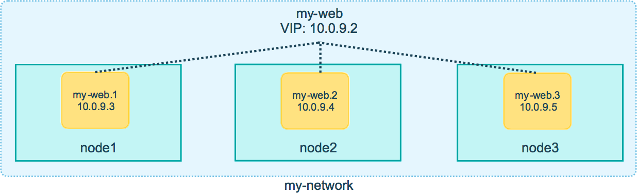

Slide 91
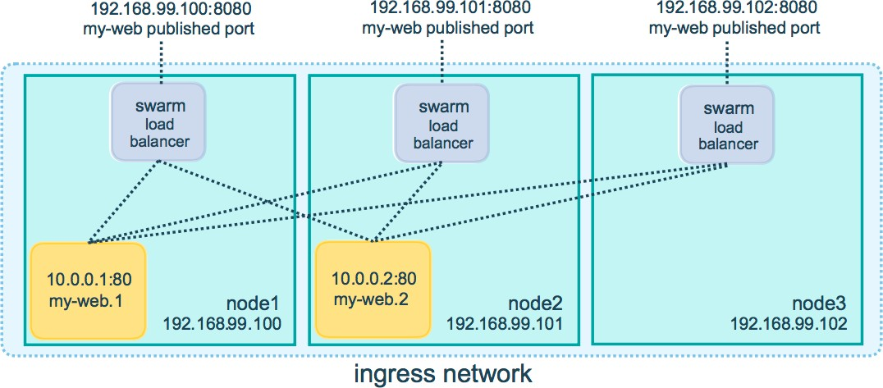

Slide 92
Routing Mesh Cont.
This is stateless load balancing
This LB is at OSI Layer 3 (TCP), not Layer 4 (DNS)
Both limitation can be overcome with:
Nginx or HAProxy LB proxy, or:
Docker Enterprise Edition, which comes with built-in L4 web proxy

Slide 93
Assignment: Create Multi-Service App
Using Docker's Distributed Voting App
use swarm-app-1 directory in our course repo for requirements
1 volume, 2 networks, and 5 services needed
Create the commands needed, spin up services, and test app
Everything is using Docker Hub images, so no data needed on Swarm
Like many computer things, this is ½ art form and ½ science

Slide 94
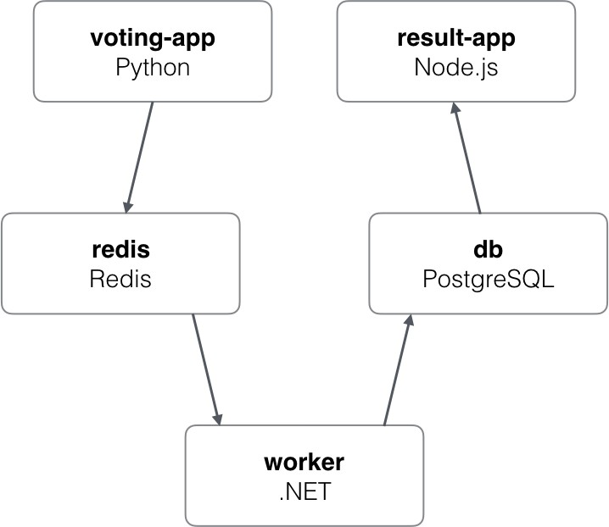

Slide 95
Stacks: Production Grade Compose
In 1.13 Docker adds a new layer of abstraction to Swarm called Stacks
Stacks accept Compose files as their declarative definition for services, networks, and volumes
We use docker stack deploy rather then docker service create
Stacks manages all those objects for us, including overlay network per stack. Adds stack name to start of their name
New deploy: key in Compose file. Can't do build:
Compose now ignores deploy:, Swarm ignores build:
docker-compose cli not needed on Swarm server

Slide 97
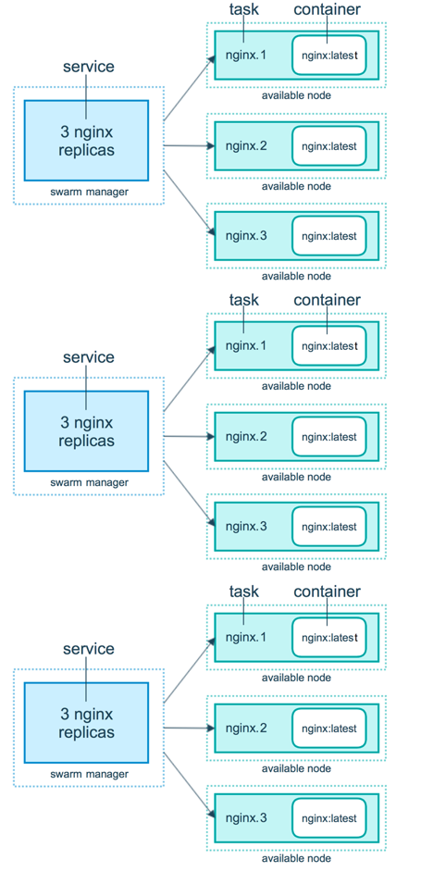
stack!
services
volumes
overlay networks

Slide 98
Secrets Storage
Easiest "secure" solution for storing secrets in Swarm
What is a Secret?
Usernames and passwords
TLS certificates and keys
SSH keys
Any data you would prefer not be "on front page of news"
Supports generic strings or binary content up to 500Kb in size
Doesn't require apps to be rewritten

Slide 99
Secrets Storage Cont.
As of Docker 1.13.0 Swarm Raft DB is encrypted on disk
Only stored on disk on Manager nodes
Default is Managers and Workers "control plane" is TLS + Mutual Auth
Secrets are first stored in Swarm, then assigned to a Service(s)
Only containers in assigned Service(s) can see them
They look like files in container but are actually in-memory fs
/run/secrets/<secret_name> or /run/secrets/
<secret_alias>
Local docker-compose can use file-based secrets, but not secure

Slide 100
Assignment: Create Stack w/ Secrets
Let's use our Drupal compose file from last assignment
(compose-assignment-2)
Rename image back to official drupal:8.2
Remove build:
Add secret via external:
use environment variable POSTGRES_PASSWORD_FILE
Add secret via cli echo "<pw>" | docker secret create psql- pw -
Copy compose into a new yml file on you Swarm node1

Slide 101
Full App Lifecycle With Compose
Live The Dream!
Single set of Compose files for:
Local docker-compose up development environment
Remote docker-compose up CI environment
Remote docker stack deploy production environment
Note: docker-compose -f a.yml -f b.yml config
mostly works
Note: Compose extends: doesn't work yet in Stacks
Fast moving part of toolset. Expect this to change/fix.

Slide 102
Service Updates
Provides rolling replacement of tasks/containers in a service
Limits downtime (be careful with "prevents" downtime)
Will replace containers for most changes
Has many, many cli options to control the update
Create options will usually change, adding -add or -rm to them
Includes rollback and healthcheck options
Also has scale & rollback subcommand for quicker access
docker service scale web=4 and docker service rollback web
A stack deploy, when pre-existing, will issue service updates

Slide 103
Swarm Update Examples
Just update the image used to a newer version
docker service update --image myapp:1.2.1 <servicename>
Adding an environment variable and remove a port
docker service update --env-add NODE_ENV=production --publish-rm 8080
Change number of replicas of two services
docker service scale web=8 api=6

Slide 104
Swarm Updates in Stack Files
Same command. Just edit the YAML file, then
docker stack deploy -c file.yml <stackname>

Slide 105
Lecture Cleanup
Remove the service we created
docker service rm web

Slide 106
Docker Healthchecks
HEALTHCHECK was added in 1.12
Supported in Dockerfile, Compose YAML, docker run, and Swarm Services
Docker engine will exec's the command in the container
(e.g. curl localhost)
It expects exit 0 (OK) or exit 1 (Error)
Three container states: starting, healthy, unhealthy
Much better then "is binary still running?"
Not a external monitoring replacement

Slide 107
Docker Healthchecks Cont.
Healthcheck status shows up in docker container ls
Check last 5 healthchecks with docker container inspect
Docker run does nothing with healthchecks
Services will replace tasks if they fail healthcheck
Service updates wait for them before continuing

Slide 108
Healthcheck Docker Run Example
docker run \
--health-cmd="curl -f localhost:9200/_cluster/health || false" \
--health-interval=5s \
--health-retries=3 \
--health-timeout=2s \
--health-start-period=15s \ elasticsearch:2

Slide 109
Healthcheck Dockerfile Examples
Options for healthcheck command
--interval=DURATION (default: 30s)
--timeout=DURATION (default: 30s)
--start-period=DURATION (default: 0s) (17.09+)
--retries=N (default: 3)
Basic command using default options
HEALTHCHECK curl -f http://localhost/ || false
Custom options with the command
HEALTHCHECK --timeout=2s --interval=3s --retries=3 \
CMD curl -f http://localhost/ || exit 1

Slide 110
Healthcheck in Nginx Dockerfile
Static website running in Nginx, just test default URL
FROM nginx:1.13
HEALTHCHECK --interval=30s --timeout=3s \ CMD curl -f http://localhost/ || exit 1

Slide 111
Healthcheck in PHP Nginx Dockerfile
PHP-FPM running behind Nginx, test the Nginx and FPM status URLs
FROM your-nginx-php-fpm-combo-image
# don't do this if php-fpm is another container # must enable php-fpm ping/status in pool.ini
# must forward /ping and /status urls from nginx to php-fpm
HEALTHCHECK --interval=5s --timeout=3s \ CMD curl -f http://localhost/ping || exit 1

Slide 112
Healthcheck in postgres Dockerfile
Use a PostgreSQL utility to test for ready state
FROM postgres
# specify real user with -U to prevent errors in log HEALTHCHECK --interval=5s --timeout=3s \
CMD pg_isready -U postgres || exit 1

Slide 113
Healthcheck in Compose/Stack Files
version: "2.1" (minimum for healthchecks) services:
web:
image: nginx healthcheck:
test: ["CMD", "curl", "-f", "http://localhost"] interval: 1m30s
timeout: 10s retries: 3
start_period: 1m #version 3.4 minimum

Slide 114
Lecture Cleanup
Remove the containers and services we created
docker container rm -f p1 p2
docker service rm p1 p2

Slide 115
Container Registries
An image registry needs to be part of your container plan
More Docker Hub details including auto-build
How Docker Store (store.docker.com) is different then Hub
How Docker Cloud (cloud.docker.com) is different then Hub
Use new Swarms feature in Cloud to connect Mac/Win to Swarm
Install and use Docker Registry as private image store
3rd Party registry options

Slide 116
Docker Hub: Digging Deeper
The most popular public image registry
It's really Docker Registry plus lightweight image building
Let's explore more of the features of Docker Hub
Link GitHub/BitBucket to Hub and auto-build images on commit
Chain image building together

Slide 117
Docker Store: What Is It For?
Download Docker "Editions"
Find certified Docker/Swarm plugins and commercial certified images

Slide 118
Docker Cloud: CI/CD and Server Ops
Web based Docker Swarm creation/management
Uses popular cloud hosters and bring-your-own-server
Automated image building, testing, and deployment
More advanced then what Docker Hub does for free
Includes an image security scanning service

Slide 119
Running Docker Registry
A private image registry for your network
Part of the docker/distribution GitHub repo
The de facto in private container registries
Not as full featured as Hub or others, no web UI, basic auth only
At its core: a web API and storage system, written in Go
Storage supports local, S3/Azure/Alibaba/Google Cloud, and OpenStack Swift

Slide 120
Running Docker Registry Cont.
Look in section resources for links to:
Secure your Registry with TLS
Storage cleanup via Garbage Collection
Enable Hub caching via "--registry-mirror"

Slide 121
Run a Private Docker Registry
Run the registry image on default port 5000
Re-tag an existing image and push it to your new registry
Remove that image from local cache and pull it from new registry
Re-create registry using a bind mount and see how it stores data

Slide 122
Registry and Proper TLS
"Secure by Default": Docker won't talk to registry without HTTPS
Except, localhost (127.0.0.0/8)
For remote self-signed TLS, enable "insecure-registry" in engine

Slide 123
Run a Private Docker Registry Recap
Run the registry image
docker container run -d -p 5000:5000 --name registry registry
Re-tag an existing image and push it to your new registry
docker tag hello-world 127.0.0.1:5000/hello-world
docker push 127.0.0.1:5000/hello-world
Remove that image from local cache and pull it from new registry
docker
docker
docker
image remove hello-world
image remove 127.0.0.1:5000/hello-world pull 127.0.0.1:5000/hello-world
Re-create registry using a bind mount and see how it stores data
docker container run -d -p 5000:5000 --name registry -v $(pwd)/ registry-data:/var/lib/registry registry

Slide 124
Private Docker Registry with Docker Swarm
Works the same way as localhost
Because of Routing Mesh, all nodes can see 127.0.0.1:5000
Remember to decide how to store images (volume driver)
NOTE: All nodes must be able to access images
ProTip: Use a hosted SaaS registry if possible

